Slide 1


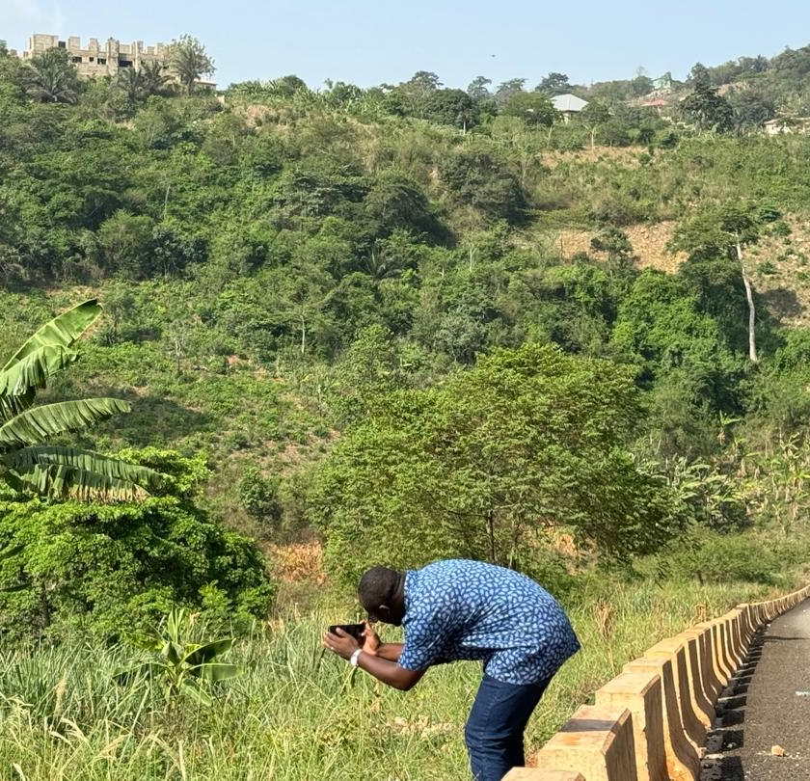
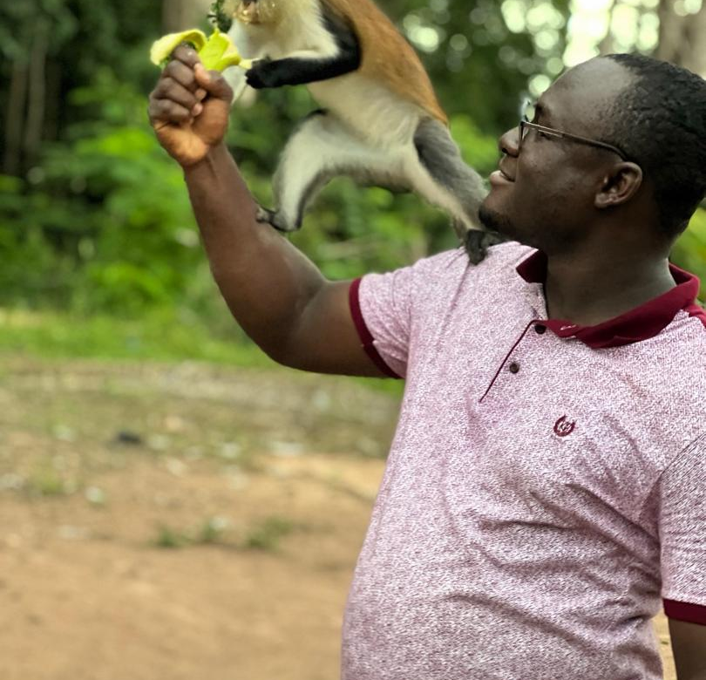
Getting to Know Me
Work
Personal
My role
Deputy Procurement Coordinator for Eastern & Ashanti Regions
Significant others / family members / furry friends in my life
H/W Nana Ama Dabbah Fynn Nkansah (Mrs)
Tenure in ofi/Olam
9 years
How I enjoy spending my free time
Watching football & movies; Nature Photography
Previous companies I have worked at
GRATIS Foundation as NSS personnel
My favorite / comfort food
Fufu & Chicken Light Soup
Why I joined ofi/Olam and what keeps me here?
Olam presented an opportunity to join the cocoa industry after developing a love for it in Senior High. The values and work environment are keeping me here
My favorite song
FINGER OF GOD – DUNSIN OYEKAN
DERRICK NKANSAH
‘DERRICK’
A few fun facts about me
I love to sing a lot
I love to like write like a poet but don’t like reading
I love to take photographs of nature
I enjoy going on Safaris
This is me outside work, doing stuff I enjoy in my life …

